Slide 1
Polygon Selection Strategy for Generalized MV Coordinates

Slide 2
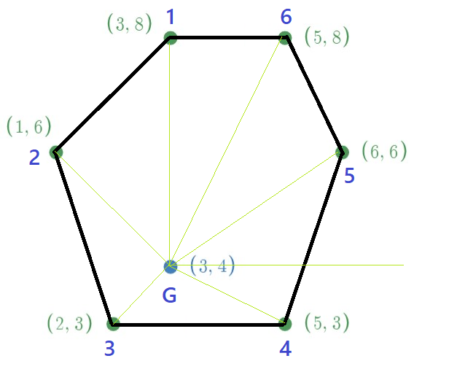
Index | Angles | Sorted Index | Sorted Angles
1 | 90.0 | 5 | 33.7
2 | 135.0 | 6 | 63.4
3 | 225.0 | 1 | 90.0
4 | 333.4 | 2 | 135.0
5 | 33.7 | 3 | 225.0
6 | 63.4 | 4 | 333.4
Index | Original MV Coordinates | MV Coordinates after Sorting | Sorted Index
1 | 4.5 | 6.6 | 5
2 | 14.0 | 3.1 | 6
3 | 47.2 | 4.5 | 1
4 | 24.6 | 14.0 | 2
5 | 6.6 | 47.2 | 3
6 | 3.1 | 24.6 | 4
Difference between minimum angle and maximum angle = 333.4-33.7
= 299.7 >180
G inside Polygon
Sequence of polygon formation: 5-6-1-2-3-4-5

Slide 3
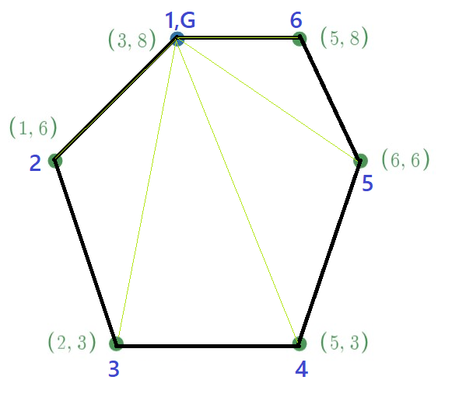
Index | Angles | Sorted Index | Sorted Angles
1 | 0.0 | 6 | 0.0
2 | 225.0 | 1 | 0.0
3 | 258.7 | 2 | 225.0
4 | 291.8 | 3 | 258.7
5 | 326.3 | 4 | 291.8
6 | 0.0 | 5 | 326.3
Index | Original MV Coordinates | MV Coordinates after Sorting | Sorted Index
1 | 100 | 0 | 6
2 | 0 | 100 | 1
3 | 0 | 0 | 2
4 | 0 | 0 | 3
5 | 0 | 0 | 4
6 | 0 | 0 | 5
Difference between minimum angle and maximum angle = 326.3-0
= 326.3 >180
G ∈ Polygon
Sequence of polygon formation: 6-1-2-3-4-5-6

Slide 4
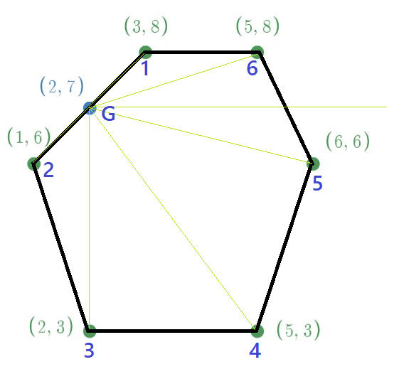
Index | Angles | Sorted Index | Sorted Angles
1 | 45.0 | 6 | 18.4
2 | 225.0 | 1 | 45.0
3 | 270.0 | 2 | 225.0
4 | 306.9 | 3 | 270.0
5 | 346.0 | 4 | 306.9
6 | 18.4 | 5 | 346.0
Index | Original MV Coordinates | MV Coordinates after Sorting | Sorted Index
1 | 50 | 0 | 6
2 | 50 | 50 | 1
3 | 0 | 50 | 2
4 | 0 | 0 | 3
5 | 0 | 0 | 4
6 | 0 | 0 | 5
Difference between minimum angle and maximum angle = 346-18.4
= 327.6 >180
G ∈ Polygon
Sequence of polygon formation: 6-1-2-3-4-5-6

Slide 5
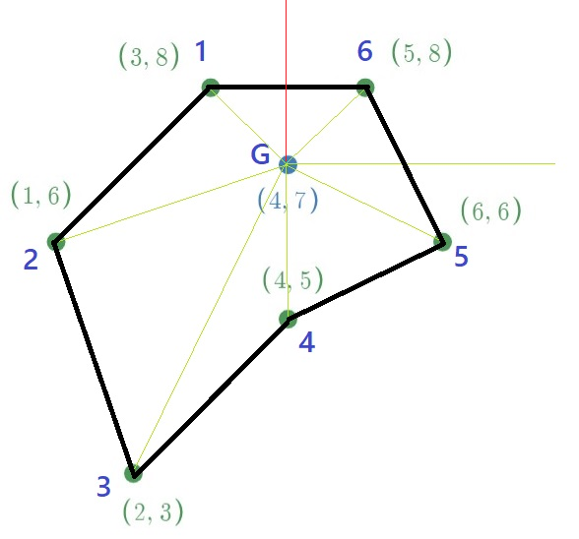
Index | Angles with Horizontal Axis | Angle with Vertical Axis
1 | 135.0 | 45
2 | 198.4 | 108.4
3 | 243.4 | 152.4
4 | 270.0 | 180
5 | 333.4 | 243.4
6 | 45.0 | 315
Max-Min | 288.4 | 270

Slide 6
Index | Angles with Horizontal Axis | Angle with Vertical Axis
1 | 166.4
2 | 189.5
3 | 218.7
5 | 226.3
6 | 152.4
Max-Min | 73.9

Slide 7
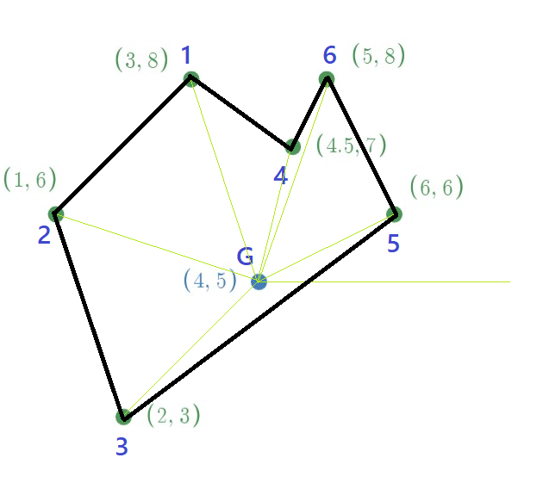
Index | Angles | Sorted Index | Sorted Angles
1 | 108.4 | 5 | 26.6
2 | 161.6 | 6 | 71.6
3 | 225.0 | 4 | 76.0
4 | 76.0 | 1 | 108.4
5 | 26.6 | 2 | 161.6
6 | 71.6 | 3 | 225.0
Index | Original MV Coordinates | MV Coordinates after Sorting | Sorted Index
1 | 6.7 | 47.1 | 5
2 | 9.1 | 2.3 | 6
3 | 27.1 | 2.6 | 4
4 | 50.5 | 4.0 | 1
5 | 0.5 | 5.7 | 2
6 | 6.1 | 38.4 | 3
Difference between minimum angle and maximum angle = 225-26.6
= 198.4 >180
G ∈ Polygon
Sequence of polygon formation: 5-6-4-1-2-3-5

Slide 8
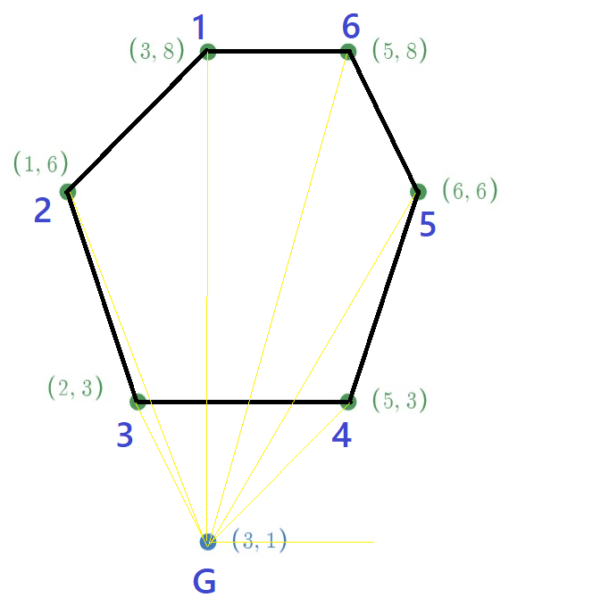
Index | Angles | Sorted Index | Sorted Angles
1 | 90.0 | 4 | 45.0
2 | 111.8 | 5 | 59.0
3 | 116.6 | 6 | 74.1
4 | 45.0 | 1 | 90.0
5 | 59.0 | 2 | 111.8
6 | 74.1 | 3 | 116.6
Index | Original MV Coordinates | MV Coordinates after Sorting | Sorted Index
1 | 6.9 | 30.8 | 4
2 | 6.3 | 6.4 | 5
3 | 44.2 | 5.4 | 6
4 | 30.8 | 6.9 | 1
5 | 6.4 | 6.3 | 2
6 | 5.4 | 44.2 | 3
Difference between minimum angle and maximum angle = 116.9-45
= 71.9 <180
G outside polygon
We can’t calculate MV coordinate for this polygon (table above gives wrong result)

